Slide 1

拥塞控制与资源分配
计 算 机 网 络
华中科技大学电信学院 2015

Slide 2
提纲
引言
  核心问题: 分配资源
资源分配问题
排队规则
TCP 拥塞控制
拥塞避免机制
服务质量(QoS)
总结
-<number>-

Slide 3
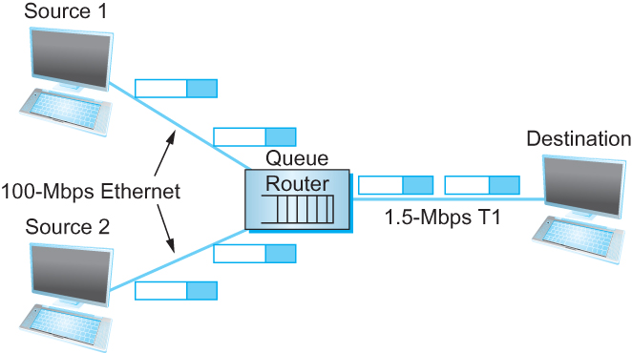
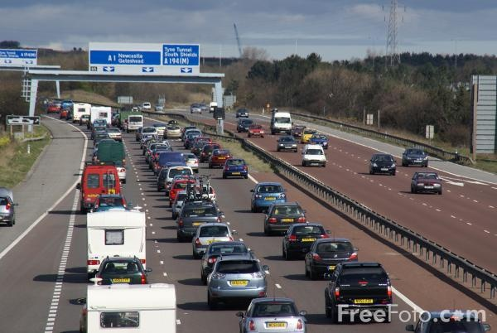
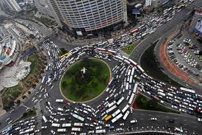
TCP可靠传输面临的新挑战
过多的TCP链接生成大量流量，
加重路由器负载
-<number>-

Slide 4

拥塞
当网络负载持续大于其承载能力则发生拥塞
拥塞现象的体现
  持续的分组丢失
  分组时延不断增加
R = 100 Mb/s
C
A
D
R = 1.5 Mb/s
B
E
分组队列
等待传输
-<number>-

Slide 5
拥塞控制和资源分配
以任意精度分配资源非常困难
  资源是分布式部署在网络中
用户的观点
  主机到主机, 端到端协议
网络的观点
  多个``流‘’竞争资源
    资源: 交换机或路由器的缓存, 链路的带宽
    拥塞: 过多的分组竞争同一条链路, 队列溢出导致分组丢弃
  如何在竞争的用户之间合理有效的分配资源?
-<number>-

Slide 6
拥塞控制和资源分配
拥塞控制和资源分配是同一事物的两个方面
如果网络承担积极主动角色
  资源分配
  预先进行网络资源分配, 例如, 调度哪一个虚电路占用物理链路
如果网络承担消极被动角色
  拥塞控制
  允许发送方想发多少数据就发多少数据, 当拥塞发生时进行恢复
-<number>-

Slide 7

核心问题
分配资源
-<number>-

Slide 8
提纲
引言
  核心问题: 分配资源
资源分配问题
排队规则
TCP 拥塞控制
拥塞避免机制
服务质量
总结
-<number>-

Slide 9
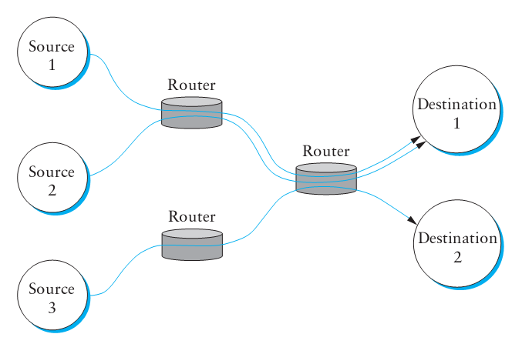
网络模型
分组交换网
无连接流
  会话开始时无资源预留
  流可以有不同粒度的定义(进程到进程, 源主机到目的主机, 等.)
服务模型
  最大努力交付: 所有分组采用相同的方式处理

Slide 10
资源分配机制的分类
以路由器为中心vs.以主机为中心
  以路由器为中心: 路由器决定什么时候转发分组, 丢弃哪些分组, 通知主机允许的发送速率
  以主机为中心: 端主机观测网络状态
  以路由器为中心和以主机为中心并不完全相互排斥
基于预留方式 vs. 基于反馈方式
  基于预留方式: 事先预留资源, 如果资源无法获得则拒绝流
  基于反馈方式: 端主机在未预留任何容量的情况下发送数据
  显式或隐式反馈
基于窗口方式 vs. 基于速率方式
  基于窗口方式: 采用与可靠传输相同的窗口机制
  基于速率方式: 接收方或网络控制速率

Slide 11


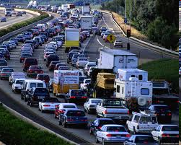
资源分配性能评估指标
评估指标用来定量分析资源分配的有效性
常用指标
  吞吐量
  时延
平衡性能
  链路利用率越高(接近100%)，吞吐量越大
  如果链路空闲，吞吐量会减小
  链路利用率越高，在路由器缓存中等待传输的分组长度越长，增加了队列等待时延
Notes:
The University of Adelaide, School of Computer Science
Chapter 2 — Instructions: Language of the Computer
A good starting point for evaluating the effectiveness of a resource allocation scheme is to consider the two principal metrics of networking: throughput and delay.
Clearly, we want as much throughput and as little delay as possible.
Unfortunately, these goals are often somewhat at odds with each other.
One sure way for a resource allocation algorithm to increase throughput is to allow as many packets into the network as possible, so as to drive the utilization of all the links up to 100%.
We would do this to avoid the possibility of a link becoming idle because an idle link necessarily hurts throughput.
The problem with this strategy is that increasing the number of packets in the network also increases the length of the queues at each router. Longer queues, in turn, mean packets are delayed longer in the network

Slide 12
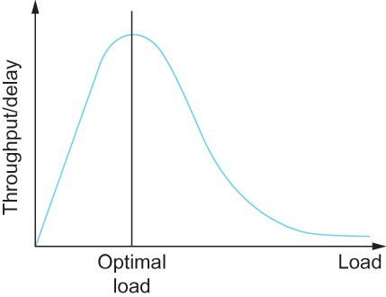
资源分配性能评估指标
有效资源分配
指标：网络能力(Power)
  吞吐量(Throughput)
  时延(Delay)
    定义：
  能力 = 吞吐量/时延
Notes:
The University of Adelaide, School of Computer Science
Chapter 2 — Instructions: Language of the Computer
Effective Resource Allocation
To describe this relationship, some network designers have proposed using the ratio of throughput to delay as a metric for evaluating the effectiveness of a resource allocation scheme.
This ratio is sometimes referred to as the power of the network.
Power = Throughput/Delay

Slide 13



资源分配性能评估指标
公平资源分配
缺乏共识：如何定义公平的资源分配？
基于预约的资源分配提供了受控的不公平方式
案例：某条链路上，我们可以预约1Mbps带宽用于传输视频流量，而相同链路上一个文件传输流仅获得10kbps
R1
1Mbps
R2
10kbps
Notes:
The University of Adelaide, School of Computer Science
Chapter 2 — Instructions: Language of the Computer
Evaluation Criteria
Fair Resource Allocation
The effective utilization of network resources is not the only criterion for judging a resource allocation scheme.
We must also consider the issue of fairness. However, we quickly get into murky waters when we try to define what exactly constitutes fair resource allocation.
For example, a reservation-based resource allocation scheme provides an explicit way to create controlled unfairness.
With such a scheme, we might use reservations to enable a video stream to receive 1 Mbps across some link while a file transfer receives only 10 Kbps over the same link.

Slide 14
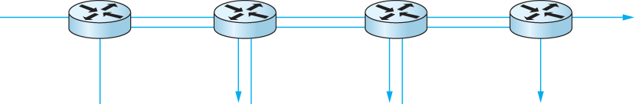
资源分配性能评估指标
公平资源分配
缺乏共识：如何定义公平的资源分配？
当多个数据流共享一段瓶颈链路，各个流应享有平等带宽份额
以上定义假设公平的带宽分配，意味着相同的带宽份额
但是，即使不考虑资源预留，相同的带宽可能并不等效于公平份额
假如我们考虑端到端的路径长度
1个4跳数据流与三个一跳数据流竞争带宽资源
Notes:
The University of Adelaide, School of Computer Science
Chapter 2 — Instructions: Language of the Computer
Evaluation Criteria
Fair Resource Allocation
In the absence of explicit information to the contrary, when several flows share a particular link, we would like for each flow to receive an equal share of the bandwidth.
This definition presumes that a fair share of bandwidth means an equal share of bandwidth.
But even in the absence of reservations, equal shares may not equate to fair shares.
Should we also consider the length of the paths being compared?

Slide 15
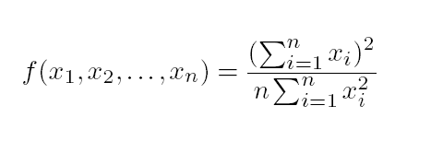
资源分配性能评估指标
公平资源分配
假设公平意味着相等，且所有的路径长度相等
Rai Jain提出公平指数，来评价拥塞控制算法的公平性
定义：假设n个数据流的吞吐量(x1, x2, . . . , xn)
公平指数是[0,1]的一个实数，1表示最公平
1个4跳数据流与三个1跳数据流竞争带宽资源
Notes:
The University of Adelaide, School of Computer Science
Chapter 2 — Instructions: Language of the Computer
Assuming that fair implies equal and that all paths are of equal length, networking researcher Raj Jain proposed a metric that can be used to quantify the fairness of a congestion-control mechanism.
Jain’s fairness index is defined as follows. Given a set of flow throughputs (x1, x2, . . . , xn) (measured in consistent units such as bits/second), the following function assigns a fairness index to the flows:
The fairness index always results in a number between 0 and 1, with 1 representing greatest fairness.

Slide 16
提纲
引言
  核心问题: 分配资源
资源分配问题
排队规则
  FIFO
  公平排队
TCP 拥塞控制
拥塞避免机制
服务质量
总结
-<number>-

Slide 17
排队规则: FIFO
调度算法 vs 缓存管理
  调度算法: 选择排队的分组在链路上传输的方式
  缓存管理：当链路缓冲区已满，对于新到达的分组是选择丢弃还是移除其他分组来容纳该分组？
FIFO: First-In-First-Out / FCFS : First-Come-First-Served
  按照分组到达次序来提供服务
缓存管理: 分组丢弃策略
  丢弃尾: 丢弃刚到达的数据包
  优先级: 按照优先级丢弃/移除
  分组随机: 随机的丢弃/移除分组
packet
arrivals
packet
departures
queue
(waiting area)
link
(server)
-<number>-
Notes:
The idea of FIFO queuing, also called first-come-first-served (FCFS) queuing, is simple:
The first packet that arrives at a router is the first packet to be transmitted
Given that the amount of buffer space at each router is finite, if a packet arrives and the queue (buffer space) is full, then the router discards that packet
This is done without regard to which flow the packet belongs to or how important the packet is. This is sometimes called tail drop, since packets that arrive at the tail end of the FIFO are dropped
Note that tail drop and FIFO are two separable ideas. FIFO is a scheduling discipline—it determines the order in which packets are transmitted. Tail drop is a drop policy—it determines which packets get dropped

Slide 18

排队规则: 优先调度
优先传输高优先级队列中的分组
不同类型的流量具有不同的优先级
  取决于分组首部的标记(如ToS字段的值)，源或目的地址，目的端口号等
high priority queue
(waiting area)
arrivals
departures
classify
link
(server)
low priority queue
(waiting area)
2
1
3
4
5
arrivals
packet in service
1
3
2
4
5
departures
1
3
2
4
5
-<number>-
Notes:
A simple variation on basic FIFO queuing is priority queuing. The idea is to mark each packet with a priority; the mark could be carried, for example, in the IP header.
The routers then implement multiple FIFO queues, one for each priority class. The router always transmits packets out of the highest-priority queue if that queue is nonempty before moving on to the next priority queue.
Within each priority, packets are still managed in a FIFO manner.

Slide 19
排队规则: 循环调度
分组被分成不同类别(与优先级排队一样)
在类之间不存在严格的服务优先级，循环调度器在这些类之间轮流提供服务。
2
1
3
4
5
link
(server)
arrivals
packet in service
1
3
2
4
5
packet
arrivals
packet
departures
departures
1
3
3
4
5
queue
(waiting area)
-<number>-
Notes:
The main problem with FIFO queuing is that it does not discriminate between different traffic sources, or it does not separate packets according to the flow to which they belong.
Fair queuing (FQ) is an algorithm that has been proposed to address this problem. The idea of FQ is to maintain a separate queue for each flow currently being handled by the router. The router then services these queues in a sort of round-robin,

Slide 20
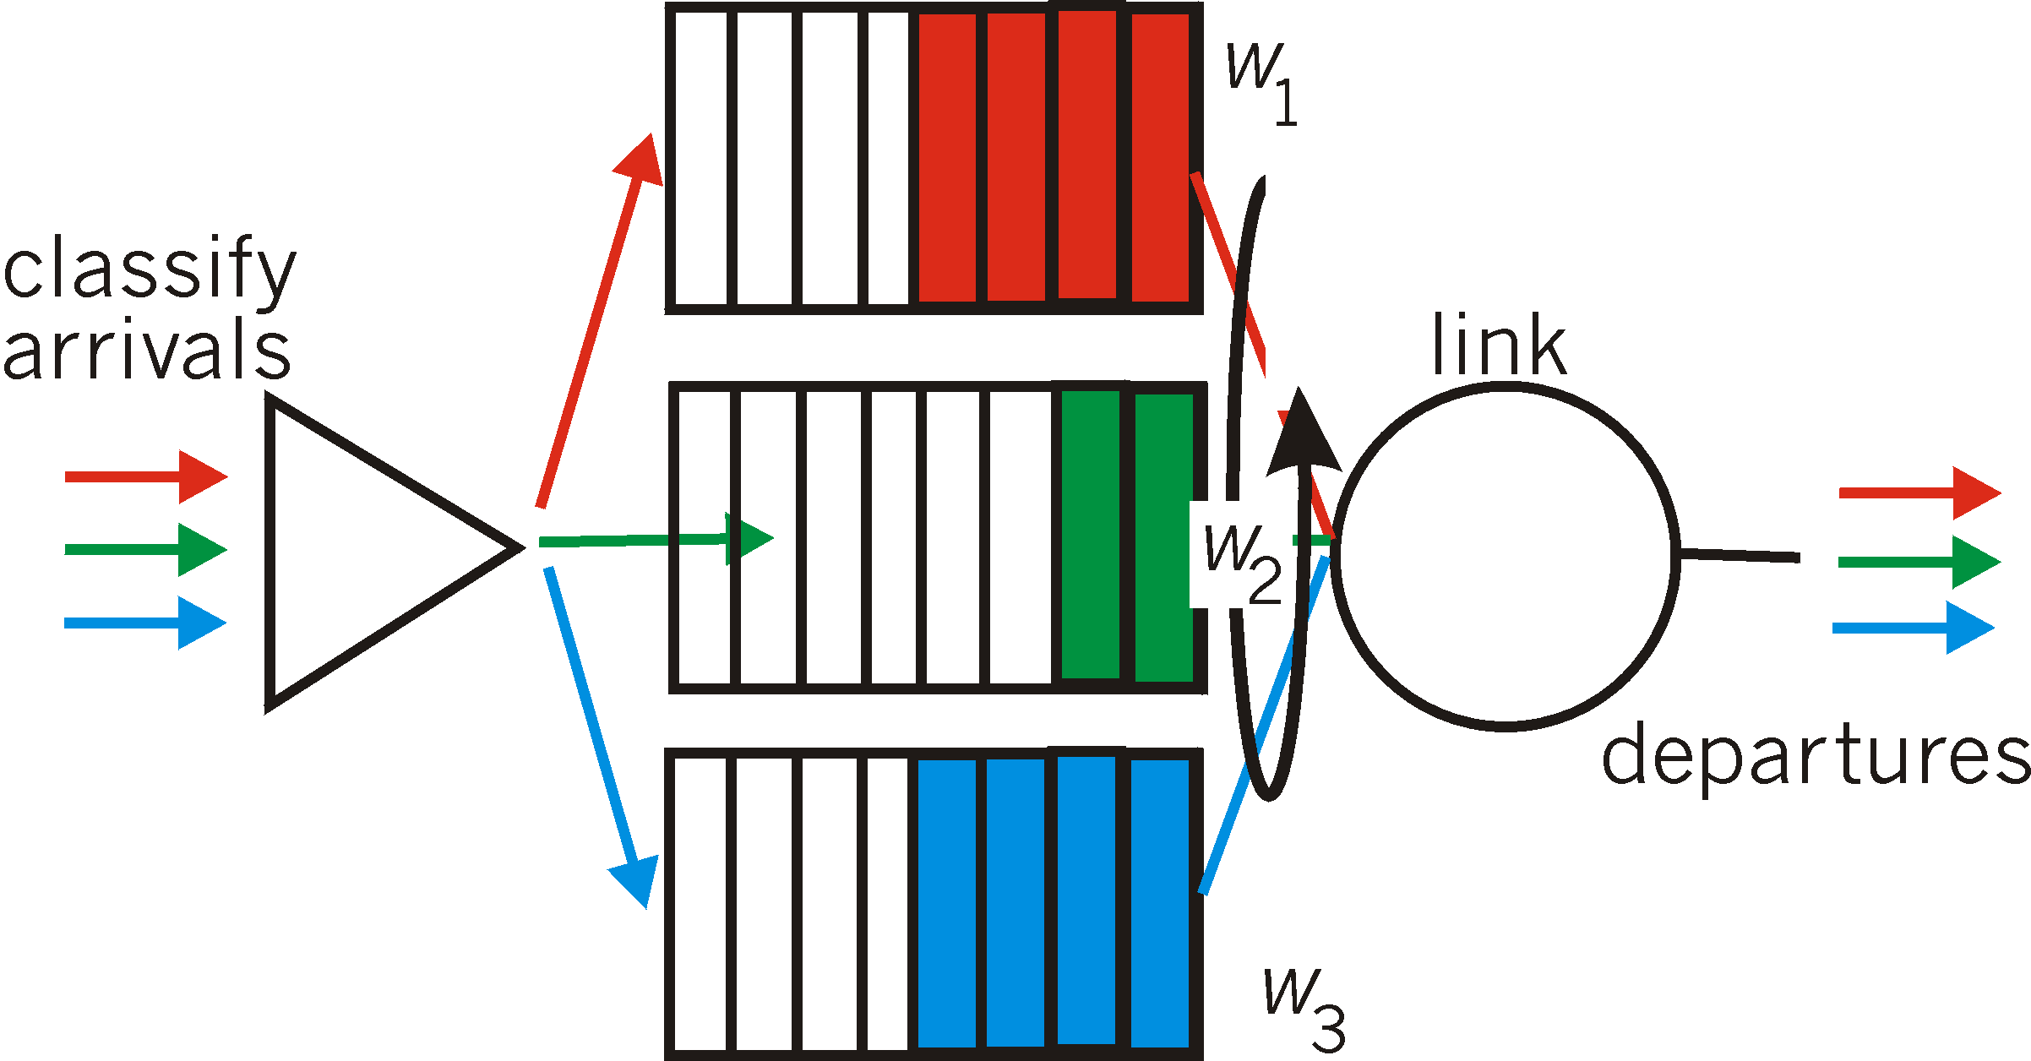
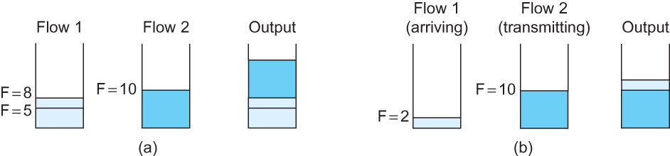
排队规则:加权公平排队调度
分组分类，在每个类的等待区域排队, 调度器循环为各类分组提供服务
每个类被分配一个加权，因此每一类在任何时间间隔内可能得到不同数量的服务
模拟比特级的循环调度，计算每个分组的发送完毕时间Fi, 并按照Fi的先后时间发送分组
-<number>-
Notes:
The main complication with Fair Queuing is that the packets being processed at a router are not necessarily the same length.
To truly allocate the bandwidth of the outgoing link in a fair manner, it is necessary to take packet length into consideration.
For example, if a router is managing two flows, one with 1000-byte packets and the other with 500-byte packets (perhaps because of fragmentation upstream from this router), then a simple round-robin servicing of packets from each flow’s queue will give the first flow two thirds of the link’s bandwidth and the second flow only one-third of its bandwidth.
What we really want is bit-by-bit round-robin; that is, the router transmits a bit from flow 1, then a bit from flow 2, and so on.
Clearly, it is not feasible to interleave the bits from different packets.
The FQ mechanism therefore simulates this behavior by first determining when a given packet would finish being transmitted if it were being sent using bit-by-bit round-robin, and then using this finishing time to sequence the packets for transmission.
To understand the algorithm for approximating bit-by-bit round robin, consider the behavior of a single flow
For this flow, let
P_{i} : denote the length of packet i
S_{i}: time when the router starts to transmit packet i
F_{i}: time when router finishes transmitting packet i
Clearly, F_{i} = S_{i} + P_{i}
When do we start transmitting packet i?
Depends on whether packet i arrived before or after the router finishes transmitting packet i-1 for the flow
Let A_{i} denote the time that packet i arrives at the router
Then S_{i} = max(F_{i-1}, A_{i})
F_{i} = max(F_{i-1}, A_{i}) + P_{i}
Now for every flow, we calculate F_{i} for each packet that arrives using our formula
We then treat all the F_{i} as timestamps
Next packet to transmit is always the packet that has the lowest timestamp
The packet that should finish transmission before all others
Example of fair queuing in action: (a) packets with earlier finishing times
are sent first; (b) sending of a packet already in progress is completed

Slide 21
提纲
引言
  核心问题: 分配资源
资源分配问题
排队规则
TCP 拥塞控制
拥塞避免机制
服务质量
总结
-<number>-

Slide 22
网络负载和拥塞
膝盖
  吞吐量缓慢增加
  时延开始快速增大
悬崖
  吞吐量开始快速减少直至为0 (拥塞崩溃)
  时延趋近于无穷大
分组丢弃
knee
cliff
吞吐量
拥塞崩溃
负载
时延
负载

Slide 23
拥塞控制和避免
增加路由器的缓存无法避免拥塞
避免拥塞的方式
  源端减少负载 – 短期
  流量工程 – 中长期
  不断增加链路的容量 – 长期
knee
cliff
吞吐量
拥塞崩溃
Load
拥塞控制
拥塞控制

Slide 24
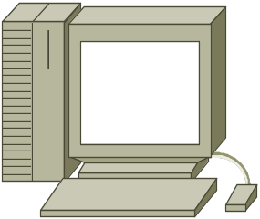

拥塞控制行为
基于主机的拥塞控制
基于主机的拥塞控制
基于路由器的拥塞控制
基于主机的拥塞控制
基于主机的拥塞控制
-<number>-

Slide 25
第6章 拥塞控制及资源分配
策略 | 路由器 | 主机 | 章节
基于主机的拥塞控制 | FIFO排队 | TCP 拥塞控制 | 6.2, 6.3
基于路由器的拥塞控制 | 主动队列管理(AQM) | TCP 拥塞控制
资源分配和拥塞避免 | 资源预留 提供QoS |  | 6.5
-<number>-

Slide 26
拥塞控制方法分类
主要分为两大类:
端到端拥塞控制:
网络不提供明确反馈信息
终端主机通过观察丢包和时延推测拥塞情况
TCP所采用
网络协助拥塞控制:
路由器向终端系统提供反馈信息
  单比特表明拥塞 (SNA, DECbit, TCP/IP ECN, ATM)
  发送端明确控制发送速率

Slide 27
TCP 拥塞控制
TCP源端调整发送速率以避免网络过载
  考虑网络的可用容量
两个基本问题
  如何察觉网络拥塞?
    以超时作为网络拥塞的标志
  如何调整发送速率?
    TCP维护一个CongestionWindow 变量
-<number>-

Slide 28
TCP拥塞窗口
每一个TCP的发送方维护一个拥塞窗口
  给定时间内允许传送的最大数据量 (未确认的)
自适应拥塞窗口
  分组丢失时减少: 退让
  成功传送时增加: 乐观的探索
  总是努力找到合适的传送速率
Tradeoff
  优点: 不需要专门的网络反馈机制
  缺点: 持续在“合适”的速率上下波动

Slide 29
接收窗口vs. 拥塞窗口
流量控制
  避免快速发送方使慢速接收方过载
拥塞控制
  避免多个发送方使网络过载
不同的概念, 但是采用类似的机制
  TCP 流量控制: 接收窗口
  TCP 拥塞控制: 拥塞窗口
  发送方TCP窗口 =
  min { 拥塞窗口, 接收窗口 }

Slide 30
加性增/乘性减(AIMD)
如何自适应变化?
  加性增: 分组成功传送, 将窗口大小增加一个最大数据段大小 (MSS)
  乘性减: 一旦分组丢失, 则将拥塞窗口减半
减小拥塞窗口的速度比加大窗口要快得多!
  窗口过大 (导致分组丢失) 比 窗口过小 (使得吞吐量减少) 危害大的多
  AIMD: TCP稳定的必要条件

Slide 31
TCP “锯齿”
窗口大小
丢失
减半
t

Slide 32
新的数据流如何启动?
慢启动(较小的CWND)避免网络过载
窗口大小
丢失
减半
t
但是, 从头开始时需要一个很长的时间!

Slide 33
慢启动
问题
  从头开始时, 累次增加需要很长的时间才能延续一个连接
动机
  采用一种更快速的方法
解决方案
  初始时设置 拥塞窗口 为一个分组
  以指数方式有效增加窗口大小直到分组丢失
-<number>-

Slide 34
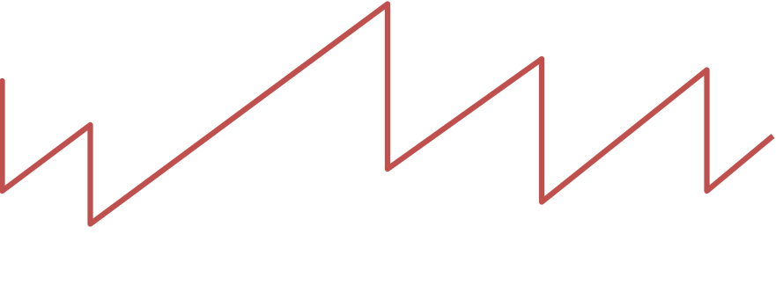
慢启动与TCP锯齿
窗口大小
丢失
减半
t
指数 “慢启动”
这种称呼（”慢”）是因为最初TCP无拥塞控制机制
源端启动时发送整个AdvertisedWindow
导致拥塞崩溃!

Slide 35
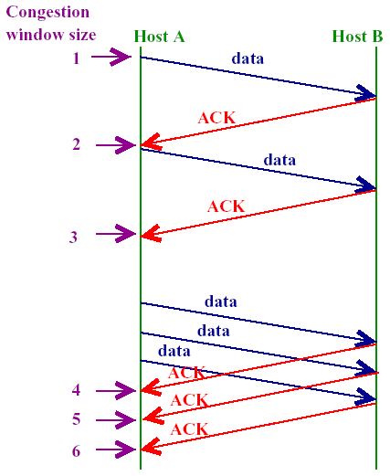
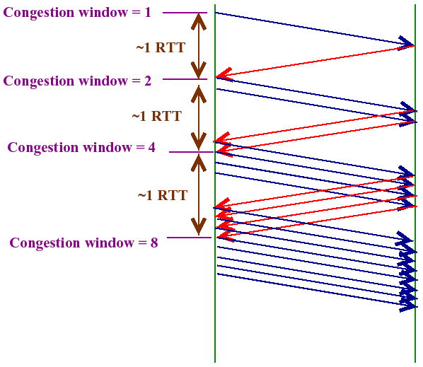
累次增加vs. 慢启动
-<number>-

Slide 36
TCP的两种丢弃
超时
  分组n丢失, 超时定时器超时
    何时? n 是窗口的最后一个分组, 或者所有发送分组均丢失
  超时后, 大的CWND会导致更严重的分组丢失
  以较小的CWND重新开始
三个重复的ACK
  分组n丢失, 但是分组 n+1, n+2, 等到达
    如何检测? 接收方多次通过ACK表示期望接收分组n
    何时? 收到分组n后续分组
  收到三个重复的ACK后, 发送方快速重传分组n
  倍数减少后累次增加

Slide 37
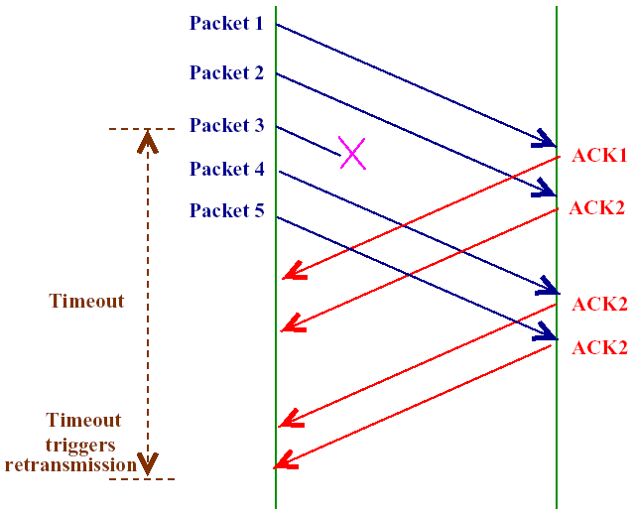
三次重复ACK
-<number>-

Slide 38
快速重传
原始重传的问题
  等待超时时会有很长一段时间连接无效
  知道第一个分组丢失
动机
  观测重复ACKs
    分组丢失
    乱序到达
解决方案
  快速重传: 如果源端收到三个重复的ACKs则不需要等待超时而快速重传
-<number>-

Slide 39
快速恢复
先前, 快速重传后慢启动
快速恢复
  去除快速重传与累次增加之间的慢启动阶段
  设置 CongestionWindow 为先前的一半 (成倍较少)
cwnd
拥塞避免
慢启动
在稳定状态下, CongestionWindow 在最优窗口大小附近振荡
Time
-<number>-

Slide 40
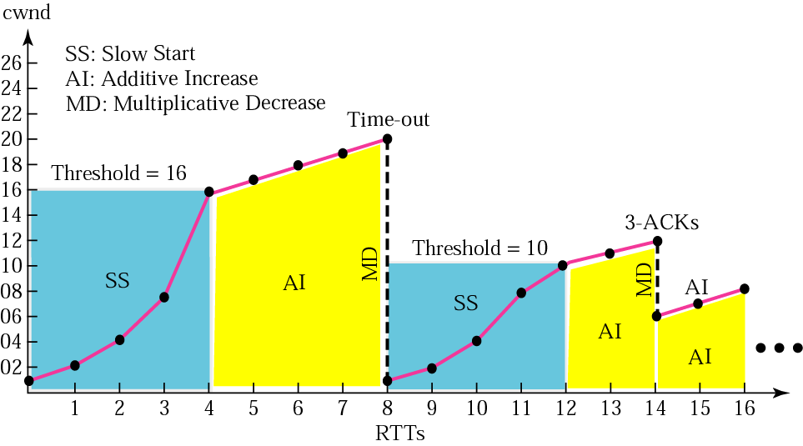
TCP拥塞控制示例
-<number>-

Slide 41
TCP的发展
RFC 793 (1981)
  基于简单滑动窗口的流量控制机制.
Tahoe (1988)
  慢启动, 拥塞避免, 快速重传.
Reno (1990)
  快速恢复.
新版Reno (1995)
  对快速重传进行了修订.
-<number>-

Slide 42
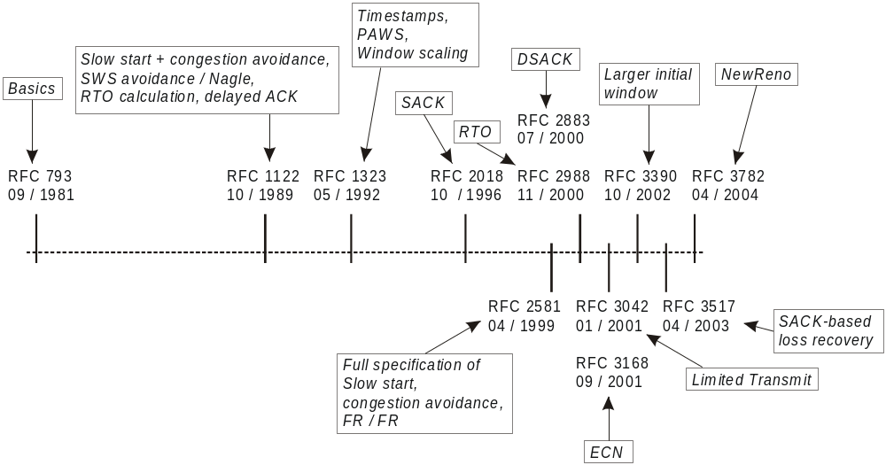
TCP的发展
-<number>-

Slide 43
TCP Reno及扩展
TCP Reno
  当今最流行的TCP实现
  集成AIMD, 慢启动, 快速重传和快速恢复
其他扩展
  选择性ACK机制: TCP SACK
  显式的拥塞通知: ECN
  基于时延的拥塞避免: TCP Vegas
-<number>-

Slide 44
提纲
引言
  核心问题: 分配资源
资源分配问题
排队规则
TCP 拥塞控制
拥塞避免机制
  DECbit
  随机早期检测(RED)
  基于源的拥塞避免
服务质量(QoS)
总结
-<number>-

Slide 45
拥塞控制和避免
增加路由器的缓存无法避免拥塞
避免拥塞的方式
  源端减少负载 – 短期
  流量工程 – 中长期
  不断增加链路的容量 – 长期
knee
cliff
吞吐量
拥塞崩溃
Load
拥塞控制
拥塞控制

Slide 46
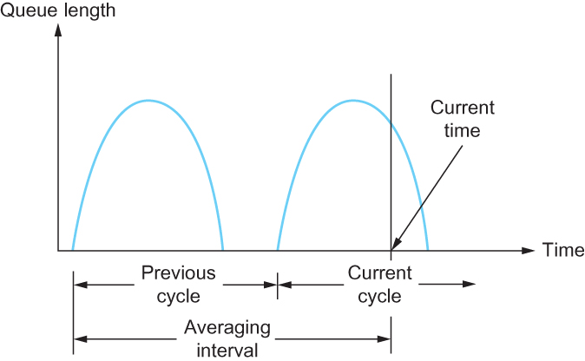
拥塞避免: DECbit
DECbit set
DECbit not set
ACK
ACK
ACK
DECbit 用于数字网络体系结构(DNA)，使用面向连接的传输层协议的一个无连接网络
路由器监视当前负载，在拥塞将发生时通过设置流经分组的DECbit通知端节点
目标主机将DECbit复制到传回源端的ACK
源主机根据收到的设置了DECbit位的ACK,控制发送窗口大小
1
Notes:
The first mechanism was developed for use on the Digital Network Architecture (DNA), a connectionless network with a connection-oriented transport protocol.
This mechanism could, therefore, also be applied to TCP and IP.
As noted above, the idea here is to more evenly split the responsibility for congestion control between the routers and the end nodes.
Each router monitors the load it is experiencing and explicitly notifies the end nodes when congestion is about to occur.
This notification is implemented by setting a binary congestion bit in the packets that flow through the router; hence the name DECbit.
The destination host then copies this congestion bit into the ACK it sends back to the source.
Finally, the source adjusts its sending rate so as to avoid congestion
A single congestion bit is added to the packet header. A router sets this bit in a packet if its average queue length is greater than or equal to 1 at the time the packet arrives.
This average queue length is measured over a time interval that spans the last busy+idle cycle, plus the current busy cycle.
Essentially, the router calculates the area under the curve and divides this value by the time interval to compute the average queue length.
Using a queue length of 1 as the trigger for setting the congestion bit is a trade-off between significant queuing (and hence higher throughput) and increased idle time (and hence lower delay).
In other words, a queue length of 1 seems to optimize the power function.
The source records how many of its packets resulted in some router setting the congestion bit.
In particular, the source maintains a congestion window, just as in TCP, and watches to see what fraction of the last window’s worth of packets resulted in the bit being set.
If less than 50% of the packets had the bit set, then the source increases its congestion window by one packet.
If 50% or more of the last window’s worth of packets had the congestion bit set, then the source decreases its congestion window to 0.875 times the previous value.
The value 50% was chosen as the threshold based on analysis that showed it to correspond to the peak of the power curve. The “increase by 1, decrease by 0.875” rule was selected because additive increase/multiplicative decrease makes the mechanism stable.

Slide 47
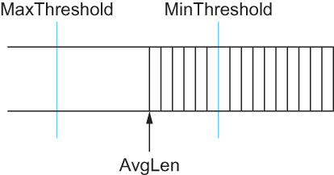
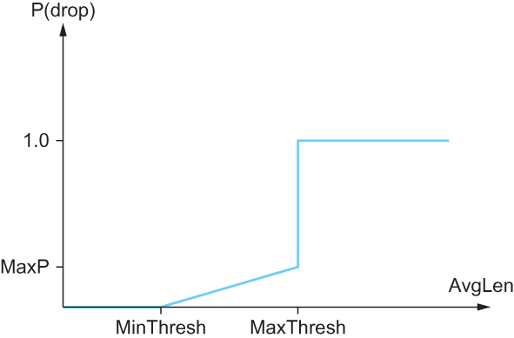
拥塞避免: RED
随机早期检测
ACK
ACK
ACK
随机早期检测
路由器监视平均队列长度，当检测到拥塞即将发生时源调整拥塞窗口
RED通过丢包隐式的通知源发生拥塞
RED应用早期随机丢弃分组
RED的参数设置影响系统性能
Notes:
A second mechanism, called random early detection (RED), is similar to the DECbit scheme in that each router is programmed to monitor its own queue length, and when it detects that congestion is imminent, to notify the source to adjust its congestion window. RED, invented by Sally Floyd and Van Jacobson in the early 1990s, differs from the DECbit scheme in two major ways:
The first is that rather than explicitly sending a congestion notification message to the source, RED is most commonly implemented such that it implicitly notifies the source of congestion by dropping one of its packets.
The source is, therefore, effectively notified by the subsequent timeout or duplicate ACK.
RED is designed to be used in conjunction with TCP, which currently detects congestion by means of timeouts (or some other means of detecting packet loss such as duplicate ACKs).
As the “early” part of the RED acronym suggests, the gateway drops the packet earlier than it would have to, so as to notify the source that it should decrease its congestion window sooner than it would normally have.
In other words, the router drops a few packets before it has exhausted its buffer space completely, so as to cause the source to slow down, with the hope that this will mean it does not have to drop lots of packets later on.
The second difference between RED and DECbit is in the details of how RED decides when to drop a packet and what packet it decides to drop.
To understand the basic idea, consider a simple FIFO queue. Rather than wait for the queue to become completely full and then be forced to drop each arriving packet, we could decide to drop each arriving packet with some drop probability whenever the queue length exceeds some drop level.
This idea is called early random drop. The RED algorithm defines the details of how to monitor the queue length and when to drop a packet.
Second, RED has two queue length thresholds that trigger certain activity: MinThreshold and MaxThreshold.
When a packet arrives at the gateway, RED compares the current AvgLen with these two thresholds, according to the following rules:
if AvgLen ≤ MinThreshold
→ queue the packet
if MinThreshold < AvgLen < MaxThreshold
→ calculate probability P
→ drop the arriving packet with probability P
if MaxThreshold ≤ AvgLen
→ drop the arriving packet
P is a function of both AvgLen and how long it has been since the last packet was dropped.
Specifically, it is computed as follows:
TempP = MaxP × (AvgLen − MinThreshold)/(MaxThreshold − MinThreshold)
P = TempP/(1 − count × TempP)
First, RED computes an average queue length using a weighted running average similar to the one used in the original TCP timeout computation. That is, AvgLen is computed as
AvgLen = (1 − Weight) × AvgLen + Weight × SampleLen
where 0 < Weight < 1 and SampleLen is the length of the queue when a sample measurement is made.
In most software implementations, the queue length is measured every time a new packet arrives at the gateway.
In hardware, it might be calculated at some fixed sampling interval.

Slide 48
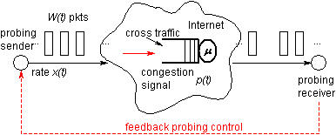
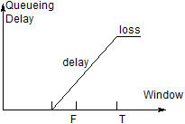
拥塞避免: 基于源
ACK
ACK
ACK
从终端主机上检测拥塞的初始阶段，即在丢失分组发生之前
当路由器的队列正在增加，如果不采取措施很快就会发生拥塞
e.g. (CurrentWindow − OldWindow)×(CurrentRTT − OldRTT)
Notes:
The general idea of these techniques is to watch for some sign from the network that some router’s queue is building up and that congestion will happen soon if nothing is done about it.
For example, the source might notice that as packet queues build up in the network’s routers, there is a measurable increase in the RTT for each successive packet it sends.
One particular algorithm exploits this observation as follows:
The congestion window normally increases as in TCP, but every two round-trip delays the algorithm checks to see if the current RTT is greater than the average of the minimum and maximum RTTs seen so far.
If it is, then the algorithm decreases the congestion window by one-eighth.
A second algorithm does something similar. The decision as to whether or not to change the current window size is based on changes to both the RTT and the window size.
The window is adjusted once every two round-trip delays based on the product
(CurrentWindow − OldWindow)×(CurrentRTT − OldRTT)
If the result is positive, the source decreases the window size by one-eighth;
if the result is negative or 0, the source increases the window by one maximum packet size.
Note that the window changes during every adjustment; that is, it oscillates around its optimal point.

Slide 49
高速TCP协议变型
基于丢包的拥塞避免 (LCA):
  HS-TCP [Flo03], S-TCP [Kel03], BIC-TCP [XHR04], CUBIC-TCP [RX05], H-TCP [SL04], and E-TCP (for small buffer) [GTHZ07]
基于时延的拥塞避免 (DCA):
  FAST TCP [JWL04]
混合式拥塞避免 (HCA):
  TCP-Africa [KBR05], Compound-TCP [TSZS06]
DCA 和HCA协议的基本思想是基于RTT的变化来检测早期拥塞，但可能存在下面的不利因素
  反向路径的排队时延影响
  由于路由变化带来的传播时延变化
  由于数据链路层带来的时延变化：Automatic Repeat reQuest (ARQ)

Slide 50
针对无线随机丢包的TCP协议变型
TCP Westwood [CGM+02, GM02]
  基于带宽估计改进TCP拥塞控制
  带宽估计方法: 带宽估计 (BE), 速率估计 (RE), 带宽/速率联合估计(CRB)
TCP Veno [FL03]: Vegas [BOP94] + Reno [Jac90]

Slide 51
提纲
引言
  核心问题: 分配资源
资源分配问题
排队规则
TCP 拥塞控制
拥塞避免机制
服务质量(QoS)
  应用需求
  端到端自适应
  综合服务(RSVP)
  区分服务(EF、AF)
  基于等式的拥塞服务
总结
-<number>-

Slide 52



多媒体应用和服务质量
多媒体应用：
网络音频和视频
(“连续媒体”)
服务
质量
网络为应用程序提供不同等级的服务质量保障
-<number>-

Slide 53
多媒体网络应用
多媒体应用的分类：
1) 流媒体存储式音频和视频
2) 直播流式音频和视频
3) 实时交互音频和视频
基本特征：
时延敏感：
  端到端的延时
  延时抖动
容忍丢包：少量数据丢失只会在音视频播放时出现少量的干扰信号
数据传输应用刚好相反：对延时不敏感 ，数据的完整性是首要需求
  时延抖动是指 同一个数据流中分组时延的变化
-<number>-

Slide 54

点播流媒体音频和视频
存储媒体：
多媒体内容预先录制存储在服务器上
流媒体：在所有数据到来之前客户端即可开始播放
连续播放：具有时限性，需满足及时播放的需求
-<number>-

Slide 55
存储式流媒体音频和视频
累积数据
2. 音视
频传送
1.音视
频源
3. 音视频接收，在客户端播放
网络
延时
时间
流媒体：客户端边下载边播放
-<number>-

Slide 56
存储式流媒体音频和视频:交互性
VCR功能：客户可以进行暂停、回放、快进等操作
  10 秒的起始时延
  1-2 秒的操作响应时延
连续播放：具有时间限制，需满足及时播放的需求
-<number>-

Slide 57
直播流媒体音频和视频
例子：
互联网上的访谈节目
赛事直播
直播流媒体 (与存储式流媒体中介绍的一样)
播放缓存
播放相对于传输可滞后数十秒
仍然具有时间限制，需满足连续播放
交互性
不能快进
有回退和暂停等操作
-<number>-

Slide 58
实时交互式音频和视频
应用： IP 电话, 视频会议, 分布式交互世界
端到端的延时需求：
  语音： 小于 150 毫秒的时延不会被听者觉察到，150-400毫秒的时延能够被接受
    包括应用层 (包封装) 和网络延时
    较高的延时会影响互动性
会话初始化
  被叫者如何通告其IP地址、端口号和编码算法？
-<number>-

Slide 59
提纲
引言
  核心问题: 分配资源
资源分配问题
排队规则
TCP 拥塞控制
拥塞避免机制
服务质量(QoS)
  应用需求
  端到端自适应
  综合服务(RSVP)
  区分服务(EF、AF)
  基于等式的拥塞服务
总结
-<number>-

Slide 60


目前互联网中的多媒体应用障碍
TCP/UDP/IP: “尽力交付的服务”
没有时延和丢包性能保障
?
?
?
?
?
?
但是：多媒体应用需要有效的
QoS 保障和不同性能等级的服务
?
?
?
?
?
互联网多媒体应用往往需要利用应用层技术来尽量补偿底层网络的延时和丢包影响。
-<number>-

Slide 61
客户端缓存及播放
变化的下载
速率x(t)
缓存水平
Q(t)
播放速率,
e.g., CBR r
视频服务器
客户端应用缓存, 大小 B
客户端

Slide 62
客户端缓存及播放
变化的下载
速率x(t)
缓存水平
Q(t)
播放速率,
e.g., CBR r
_x0013_
视频服务器
客户端应用缓存, 大小 B
客户端
1. 首先缓存流量，直到t_{p}开始播放
2. t_{p}时刻开始播放
3. 因为下载速率随时间变化，而视频播放速率是常数，缓存水平不断变化

Slide 63
客户端缓存及播放
变化的下载
速率x(t)
缓存水平,
Q(t)
播放速率,
e.g., CBR r
视频服务器
客户端应用缓存, 大小 B
播放缓存: 平均下载速率 (x), 播放速率 (r):
x < r: 缓存最终变空 (停止视频播放，直到缓存下载到新的视频内容)
x > r: 缓存不会为空, 只要最初的缓存时延足够大，可以抵消下载速率的变化
  平衡初始的缓存时延: 更大的缓存时延会减少缓存为空的可能，但会造成用户等待更长的时间才能开始观看视频

Slide 64
流媒体: UDP
服务器以合适的速率向客户端发送流量
  一般而言: 发送速率 = 编码速率 = 常数速率
  传输速率可以不响应网络拥塞水平
引入较短的播放延迟 (2-5 seconds)，补偿网络时延变化的影响
错误恢复:
  在应用层实现
  根据时延允许的情况，可自适应调整
RTP [RFC 2326]: 定义不同的多媒体载荷类别
UDP可能无法穿透防火墙

Slide 65

流媒体: HTTP
传输多媒体文件：HTTP GET
以TCP的最大可能速率传输
下载速率变化
  TCP拥塞控制
  TCP重传(顺序传输)
较大的初始播放时延: 平滑TCP传输速率
HTTP/TCP更容易穿透防火墙
_x0013_
变化速率, x(t)
_x0013_
_x0013_
视频文件
TCP发送缓存
TCP接收缓存
应用播放缓存
服务器
客户端

Slide 66
流媒体: DASH
DASH: Dynamic, Adaptive Streaming over HTTP
服务器:
  视频文件切割为多个数据块
  每个数据库以不同的速率编码及存储
  说明文件: 不同数据块有对应的URLs
客户端:
  周期性测量服务器到客户端的带宽
  参考说明文件，一次请求一个数据块
    根据当前的网速限制，选择最大的编码速率
    基于当时的可用带宽，不同时间可选择不同编码速率

Slide 67
流媒体: DASH
DASH: Dynamic, Adaptive Streaming over HTTP
智能客户端: 客户端决定
  什么时候 请求数据块 (避免缓存为空或者用尽)
  请求什么编码速率 (当可用带宽更大，选择更高质量的视频流)
  从哪里下载数据块 (可以从距离客户端更近或者可用带宽更多的服务器下载)

Slide 68
提纲
引言
  核心问题: 分配资源
资源分配问题
排队规则
TCP 拥塞控制
拥塞避免机制
服务质量(QoS)
  应用需求
  端到端自适应
  综合服务(RSVP)
  区分服务(EF、AF)
  基于等式的拥塞服务
总结
-<number>-

Slide 69
互联网架构应如何演化才能更好地支持多媒体？
综合服务(IntServ):
对互联网做根本性变革，能够明确地预留端到端的带宽并因此获得端到端的性能保证
在主机和路由器都需要新的、复杂的软件及新的服务类型
自由放任的方法：
不必对支撑互联网的协议做任何根本的改变
按需分配带宽
内容分发网络，多播覆盖网络
区分服务(DiffServ)：
只需对互联网基础设施做少量变化，但是只能提供级别数目有限的服务。
你对此有何看法？
-<number>-

Slide 70
QoS 保证原则
基本原则: 流量需求不能超过链路容量
1 Mbps
电话
R1
R2
1 Mbps
电话
1.5 Mbps链路
原则 1
如果网络没有充足的资源，但要保证应用的QoS，则需要一个呼
叫准入过程，根据流声明的QoS需求，要么网络接受服务请求，
要么拒绝服务请求。
-<number>-

Slide 71
QoS 保证
资源预留
  呼叫建立的信令 (RSVP)
  所希望的QoS流量特征和规范
  每个元素呼叫准入
请求/
应答
  QoS 呼叫信令建立
-<number>-

Slide 72
IETF综合服务(IntServ)
用于在互联网中为各个应用会话提供个性化的QoS保证
资源预留：路由器需要维护资源分配的状态信息和QoS 需求
准许/拒绝新的呼叫请求：
问题:新到的流在不影响已经建立会话的服务质量前提
下能否获得性能保证？
-<number>-

Slide 73
呼叫接纳
到达的会话必须 :
声明QoS需求
  R-spec：定义一个呼叫要求的具体QoS
向网络发送的流量特性
  T-spec: 定义流量特性
信令协议: 将 R-spec和T-spec提交到路由器 进行资源预留
  RSVP
-<number>-

Slide 74
综合服务 (IntServ)[RFC2211, RFC2212]
有服务保证的服务：
为分组提供了在路由器中经受的排队时延的严格界限。使用用漏桶监管机制来刻画流量特性。
受控的负载服务：
一个呼叫将接收与相同流在无负载网络单元中获得的QoS非常接近的服务质量
到达的
流量
令牌速率, r
桶的大小, b
每个流
速率, R
WFQ
D = b/R
max
-<number>-

Slide 75
互联网中的信令
通过无连接的IP
路由器转发分组
+
=
初始网络协议设
计时无信令协议
尽力而为服务
新需求：沿着端到端的路径预留资源以向多媒体应用提供QoS保证
RSVP：资源预留协议 [RFC 2205]
  允许用户以健壮、高效的方式与网络交互需求(信令)
早期的互联网信令协议: ST-II [RFC 1819]
《网络专题选讲 》
-<number>-

Slide 76
RSVP设计目标
数据的接收方发起并维护用于该流的资源预留
预留不同的资源以适应不同的应用
提供多播树中的带宽预留，以适应多播组成员
利用现有多播/单播路由器，以适应单播/多播路由器的改变
控制协议开销随着接收方数量的增加线性增长
模块化设计以支持不同的基础技术
《网络专题选讲 》
-<number>-

Slide 77
RSVP所不能做的：
没有定义网络向数据流提供预约带宽的方法。
  只是一个允许应用预约必要链路带宽的协议
不指定分组经过哪些路由器
  这是路由协议的工作
  信令与路由器分离
不参与转发数据分组
  分离控制(信令)和数据(转发)传输
《网络专题选讲 》
-<number>-

Slide 78
RSVP: 运行概述
发送方、接收方加入到多播组
  在RSVP之外完成
  发送方无须加入组
发送方到网络的信令
  链路消息: 使路由器知道发送方的存在
  链路撤销: 在服务器中删除发送方的链路状态
接收方到网络的信令
  预留消息: 预留从发送方到接收方的资源
  预留撤销: 移除对接收方的资源预留
网络到终端系统的信令
  链路错误
  预留错误
《网络专题选讲 》
-<number>-

Slide 79
提纲
引言
  核心问题: 分配资源
资源分配问题
排队规则
TCP 拥塞控制
拥塞避免机制
服务质量(QoS)
  应用需求
  端到端自适应
  综合服务(RSVP)
  区分服务(EF、AF)
  基于等式的拥塞服务
总结
-<number>-

Slide 80

提供多个服务等级
当今互联网对所有应用提供尽力而为服务。
  应用将得到网络能够提供的任何等级的性能
强化服务模型：提供多个等级的服务
  将流量分为多个类别
  网络为不同的流量提供不同等级的服务。 (类似于VIP 服务与常规服务)
聚合流量：同一种流量类别在网络中得到相同的对待，独立于特定的它们所属的端到端连接。
IPv4首部中的服务类型字段(ToS)
0111
-<number>-

Slide 81

研究动机：场景
H1
H3
R1
R2
H4
H2
R1 输出接
口队列
1.5 Mbps链路
-<number>-

Slide 82
情况 1: 音频应用和FTP传输
例子: 1Mbps IP 电话, FTP 分享 1.5 Mbps 链路.
  FTP源产生的突发分组可能潜在地填充满队列导致音频分组延迟或丢失
  为音频分组分配严格的优先级
R1
R2
原则2
分组分类使得路由器可以区分属于不同类型流量的分组
-<number>-

Slide 83
QoS保证原则
如果应用程序发生异常怎么办 (如音频以比声明速率更高的速率发送)
  监管: 强迫源按照一定的标准发送流量
在网络边缘进行标记与监管:
  类似于ATM UNI (用户网络接口)
1 Mbps
电话
R1
R2
1.5 Mbps 链路
分组标记与监管
原则3
在不同数据流之间提供保护或隔离，使一类流量不会受到另一类异常流量的负面影响
-<number>-

Slide 84
QoS保证原则
给每个应用流分配固定量的链路带宽： 一个流量类型不能利用其他应用现在不使用的带宽，带宽利用率降低
1 Mbps
电话
逻辑链路1 Mbps
R1
R2
1.5 Mbps 链路
逻辑链路0.5 Mbps
原则4
当为不同数据流提供隔离时，希望尽可能
有效地利用资源
-<number>-

Slide 85
监管机制
目标: 调节流向网络的分组速率
三种重要的监管准则：
平均速率: 限制一个流的分组能够发送到网络中的长期平均速率
  关键问题: 监管的时间间隔。每秒100个分组比每分钟6000个分组约束更严格
峰值速率: 限制在一个较短的时间能够发送的最大分组数。例如：以每分钟6000个分组的平均速率来监管一个流，但限制峰值速率为每秒1500个分组
突发长度：限制在极短的时间间隔能够发送到网络中的最大分组数
-<number>-

Slide 86
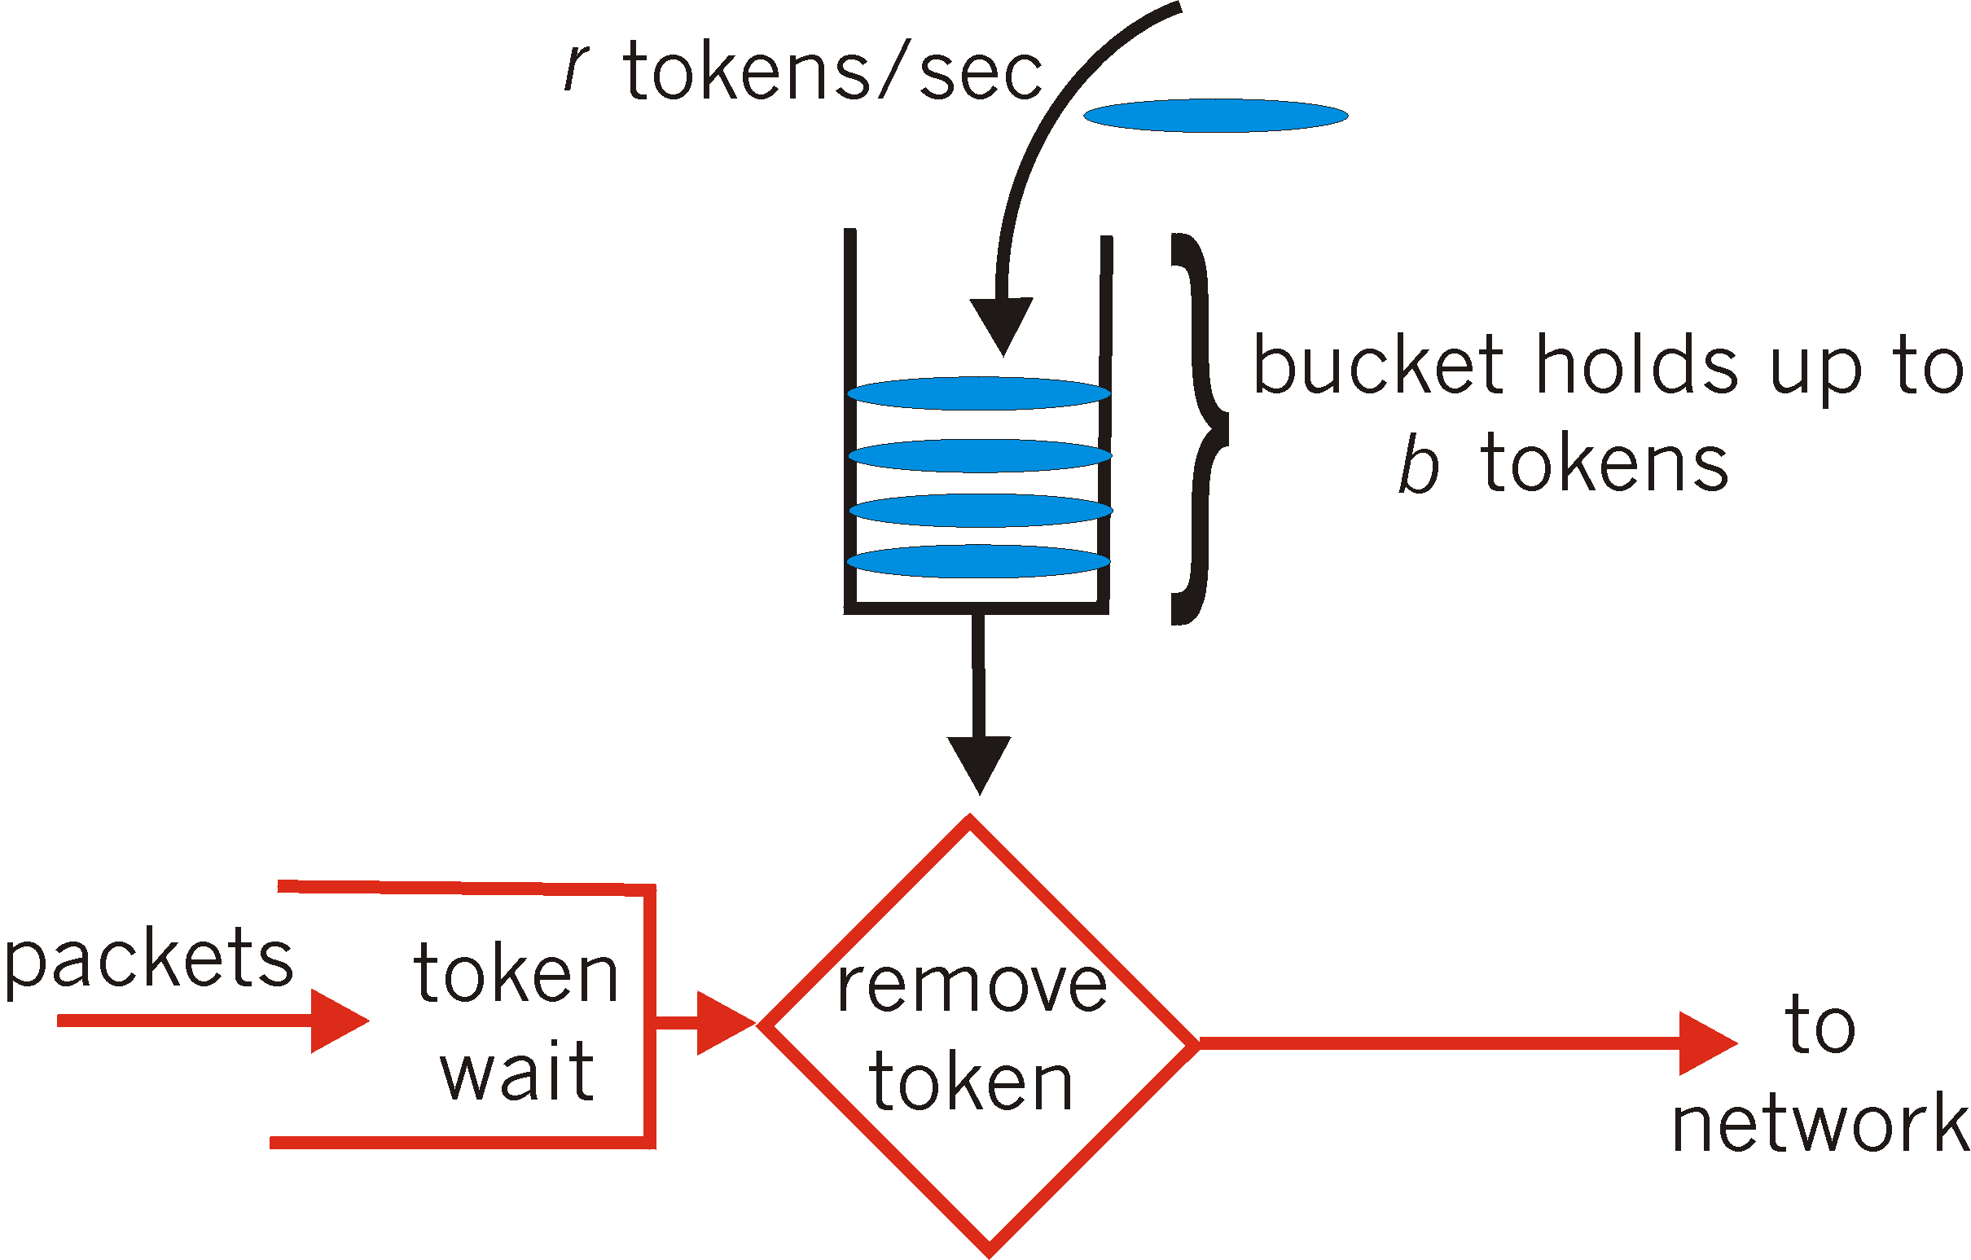
监管机制
漏桶机制： 对流的最大突发长度与平均速率进行限制
桶中最多装入b个令牌
令牌以每秒钟r个的速率加入到桶中直到桶装满b个令牌
在任何长度t的时间间隔内能够进入到网络中的最大分组数目为rt+b
-<number>-

Slide 87
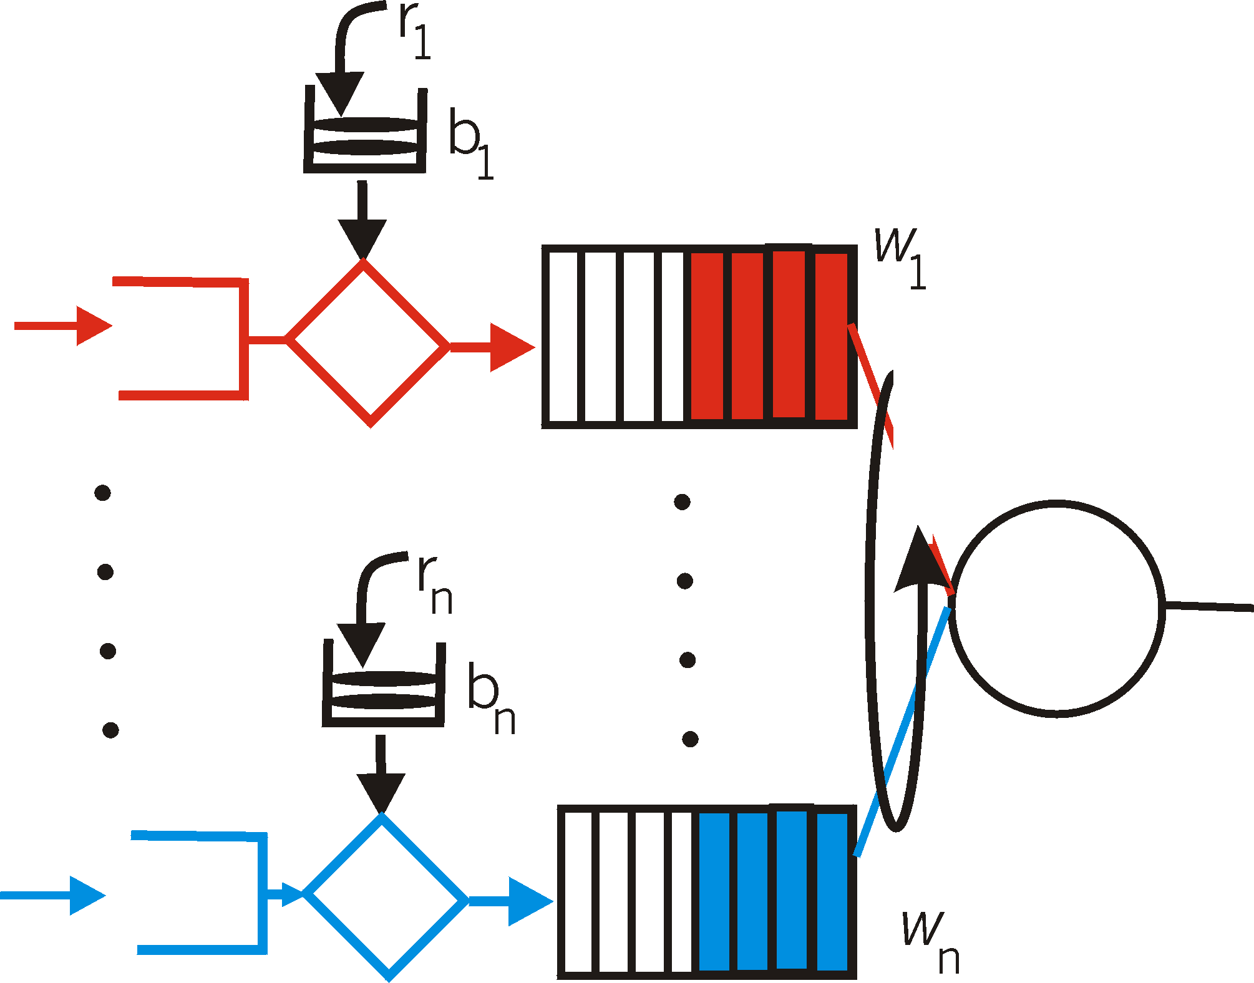
监管机制
漏桶与加权公平排队相结合，控制队列中的最大时延
到达的
流量
令牌生成速率, r
桶的大小, b
每个流
速率, R
WFQ
D = b/R
max
-<number>-

Slide 88
区分服务(DiffServ)
以一种可缩扩和灵活的方式处理不同”类别”的流量
可缩扩性: 在网络核心放置简单功能，在网络边缘放置相对复杂功能
灵活性：不定义服务类别，提供功能组件来构造不同等级的服务
-<number>-

Slide 89

区分服务体系结构
标记
r
边缘路由器：
分组分类和流量调节
标记分组为 in-profile 和 out-profile
b
调度
.
.
.
核心路由器:
基于流量类别的转发
根据分组标记进行缓冲与调度
优先考虑 in-profile 分组
-<number>-

Slide 90
边缘路由器分组标记
流量配置文件: 包含对峰值速率和分组流的突发度的限制
速率 A
B
用户分组
符合流量配置文件的分组得到它们的优先级标记并被转发
违反流量配置文件的分组可能被打上不同的标记，或被整形，或被丢弃。
-<number>-

Slide 91
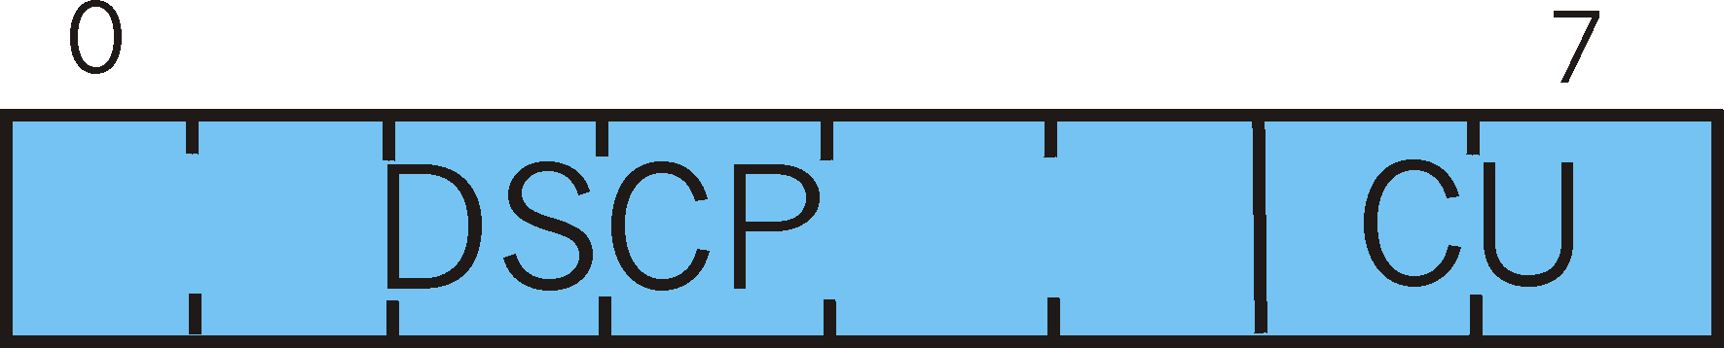
分类和调节
分组标记携带在IPv4 服务类型字段或IPv6分组首部DS字段
6 比特用于区分服务类型(DSCP) 并且确定将接收分组的每跳行为
2比特暂时不使用
-<number>-

Slide 92
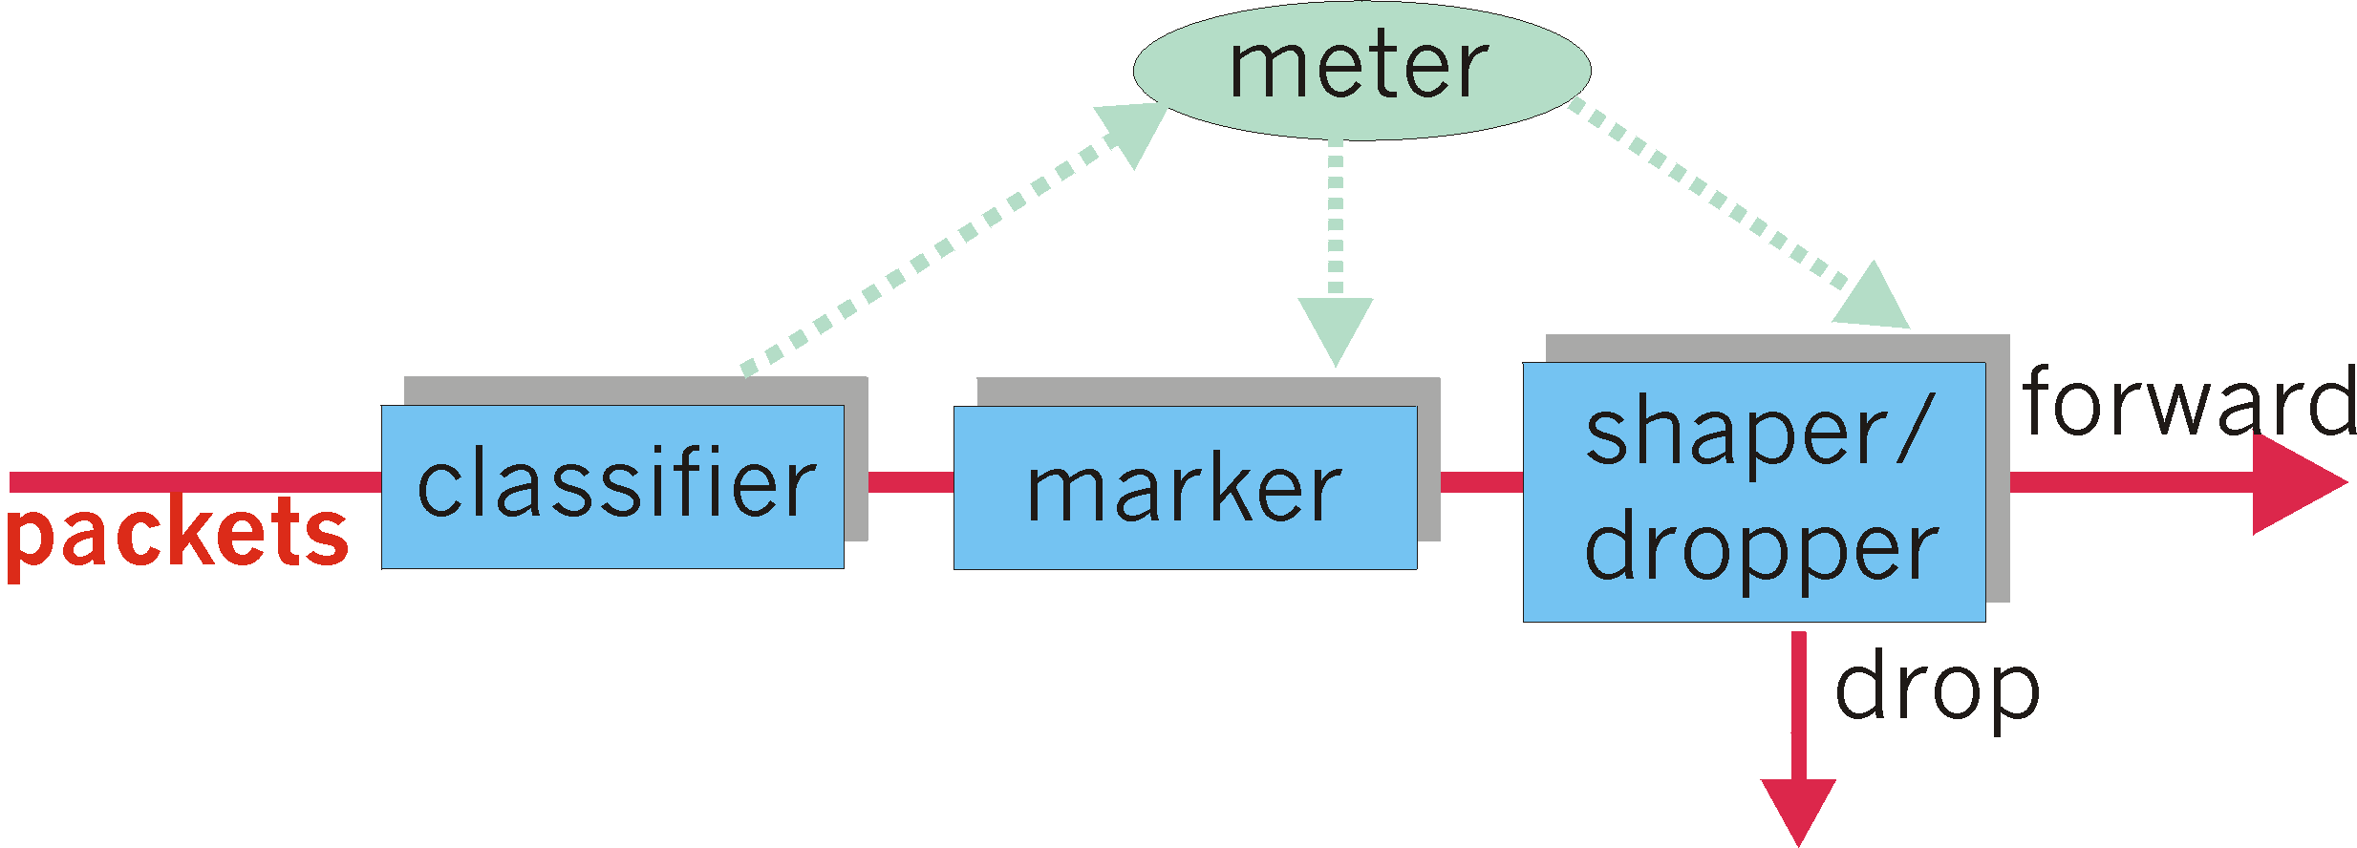
分类和调节
可以限制分组发送速率：
用户定义流量配置文件(包括平均速率和突发长度)
分组标记，整形功能
-<number>-

Slide 93
每跳行为(PHB)
PHB：外部可观察的转发行为的描述，应用特定的Diffserv行为聚合
PHB使得不同服务类别的流量能享受到不同网络服务性能
PHB 不限制特定机制以获得这些性能
例如：一个PHB不要求为了获得一个特定行为而使用特定的分组排队规则(优先级队列，加权公平排队或先来先服务队列)
-<number>-

Slide 94
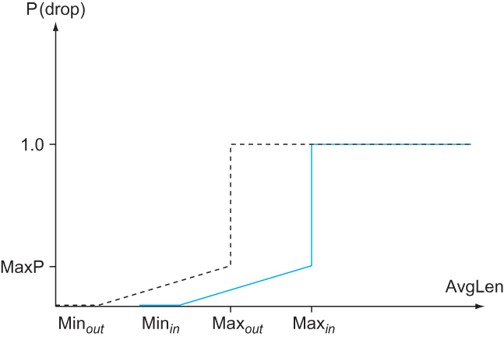
每跳行为 (PHB)
加速转发PHB(EF): 一类流量离开路由器的速率必须等于或者大于一个已配置的速率
  为一个流量类别提供了最小保障的链路带宽
确保转发PHB(AF): 将流量分为4类
  每个类都确保提供某种最小数量带宽和缓冲区
  每一类进一步划分为三个“丢弃优先级”
-<number>-

Slide 95
提纲
引言
  核心问题: 分配资源
资源分配问题
排队规则
TCP 拥塞控制
拥塞避免机制
服务质量(QoS)
  应用需求
  端到端自适应
  综合服务(RSVP)
  区分服务(EF、AF)
  基于等式的拥塞服务
总结
-<number>-

Slide 96
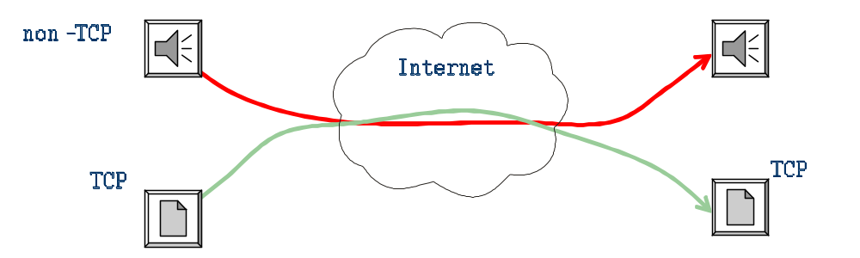
基于等式的拥塞控制: 动机
只有所有数据流都配合，拥塞控制才能有效
不受限制的UDP流量会影响TCP吞吐率
使用什么方式规范UDP流，使其响应网络拥塞？
-<number>-

Slide 97
多媒体传输: TCP vs UDP
流媒体很少使用TCP
  TCP重传机制引入额外时延(>500ms)
  当接收端收到重传数据，已经超过播放时间点
  AIMD引入时延抖动和吞吐率变化过快
  无必要引入TCP流控: 接收端需要以编码速率处理数据
为什么关注TCP
  互联网流量主要使用TCP
  非TCP流量已经非常影响TCP流量
一般而言，多媒体应用主要使用UDP
  如何使UDP流量做到TCP友好？
-<number>-

Slide 98
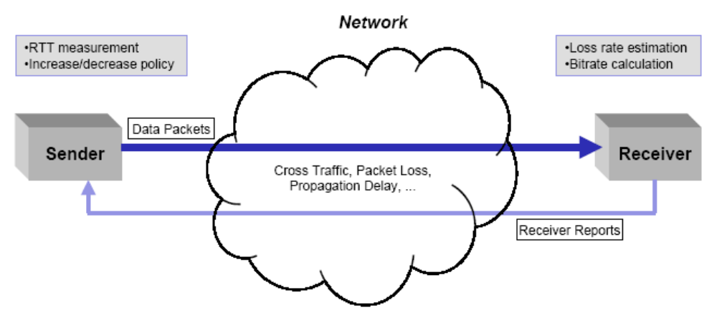
基于等式的拥塞控制: 基本想法
定义: 在同样的网络条件下，某个链接的长期吞吐率不超过一个TCP流的吞吐率
使UDP流看起来像TCP流，避免过于激进的发送流量
  激进的数据流可能受到路由器主动缓存控制机制的打压
  不希望是其他TCP流吞吐率过低
目标
  缓慢适应拥塞窗口
  公平竞争条件下，实现TCP友好
方法：测量RTT和丢包率，根据TCP吞吐率公式，控制发送速率
-<number>-

Slide 99
提纲
引言
  核心问题: 分配资源
资源分配问题
排队规则
TCP 拥塞控制
拥塞避免机制
服务质量
总结
-<number>-

Slide 100
拥塞控制
拥塞是不可避免的
  Internet中不会预先进行资源分配
  基于主机vs.基于路由器的拥塞控制
TCP 拥塞控制
  采用分组丢失作为拥塞的判别标示
  发送方采用CongestionWindow 适应网络
  累次增加, 成倍减少
  慢启动, 缓慢开始重启
-<number>-

Slide 101
TCP 设计: 问题及解决方案
No. | 问题及挑战 | 解决方案 | 章节
1 | 连接建立 | 建立: 三次握手 终止: 四次握手 | 5.2.3
2 | 超时定时器问题 | 采用Jacobson/ Karels算法估计RTT | 5.2.6
3 | 分组乱序到达 | 基于窗口的缓存管理 | 5.2.4
4 | 流量控制 | 通过AdvertisedWindow通告实现基于窗口的流量控制 | 5.2.4
5 | 拥塞控制 | 基于CongestionWindow实现拥塞控制 | 6.3
6 | 协议扩展 | TCP首部的Seq和AdvertisedWindow字段扩展 | 5.2.4
7 | 傻瓜窗口症状 | Nagle 算法: 基于ACK自计时 | 5.2.5
-<number>-

Slide 102
服务质量保证
服务器：多速率视频编码
网络支持：资源预留
请求/
回答
  网络支持：面向服务质量的调度 (e.g., WFQ)
客户端：自适应速率调整

Slide 103
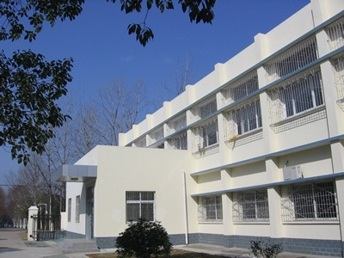
谢谢！
华中科技大学
电子信息与通信学院
Email: itec@hust.edu.cn
网址：http://itec.hust.edu.cn

Slide 104
参考资料
Chapter 6 in L. L. Peterson and B. S. Davie, Computer Networking: A System Approach (5th edition), Morgan Kaufmann, 2012
Chapter 3/7 in James F. Kurose and Keith W. Ross, Computer Networking: A Top-Down Approach (6th edition), Pearson Education Inc., 2012
吴功宜，计算机网络（第3版）,清华大学出版社，2011

Slide 105
附录

